Slide 1

AIML CA1
PART B: Predicting Housing Price

Slide 2
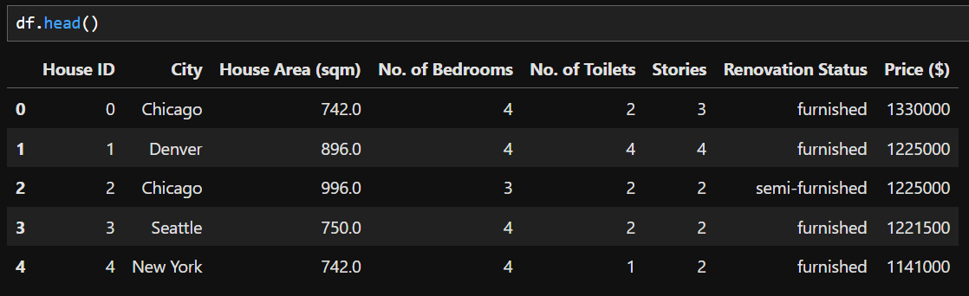
Data Exploration
After loading the data, I did df.head() to see what the first few rows of values look like. City and Renovation Status is categorical and the rest of the data besides House ID as it is irrelevant, are numeric values

Slide 3
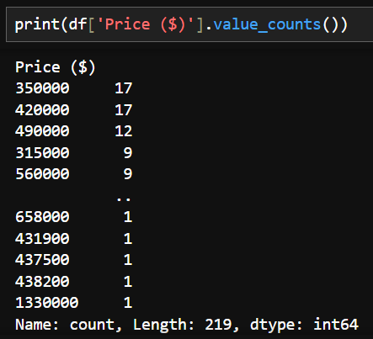
Data Exploration
Next, I checked the data type of the target variable, Price and the distribution of the values. Using df[‘Price'].value_counts(), we can see that the target is a range of values where, so this will be a regression task.
It also shows that this is a small dataset.

Slide 4
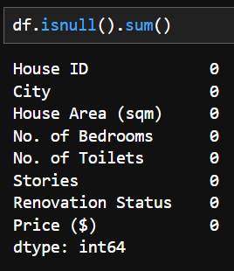
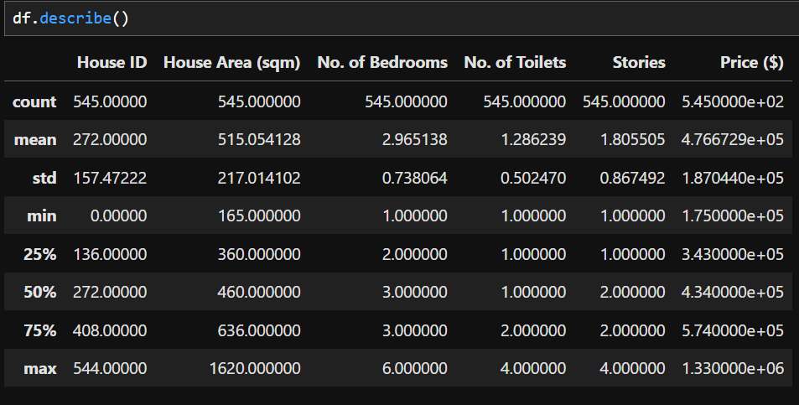
Data Exploration
Finally, I used df.isnull().sum() to see if there was any missing values and the amount. We can see that there are no missing data. df.describe() also shows that House Area, No. of Bedrooms, No. of Toilets, and Stories do not have 0 as the minimum value, which confirms it.

Slide 5
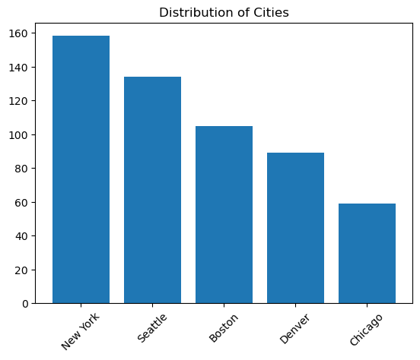
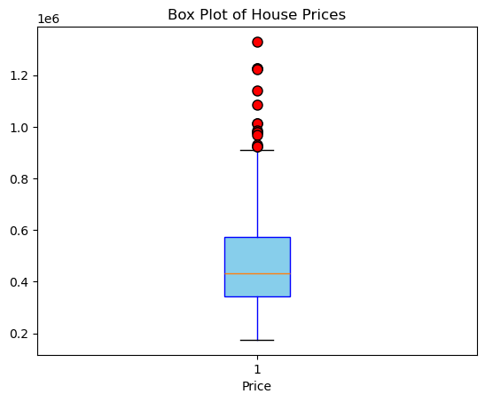
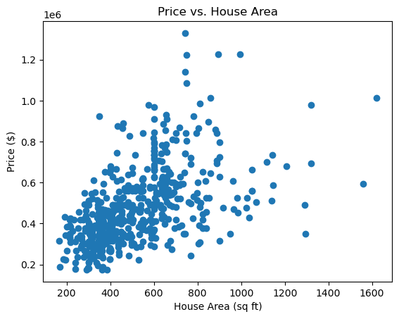
Data Visualisation

Slide 6
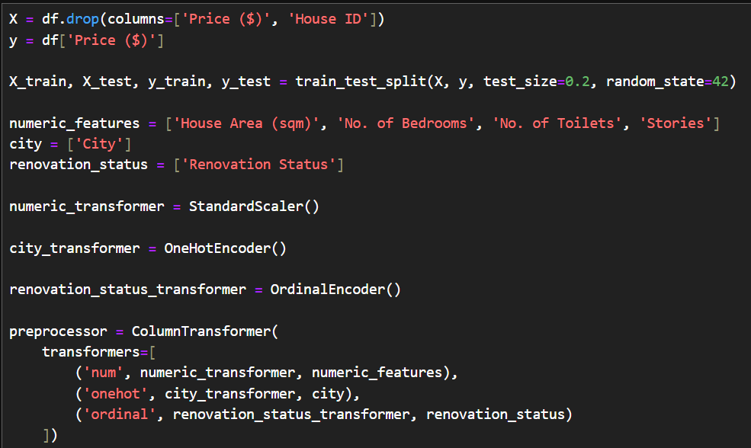
Data Preprocessing
For all the numeric values, I used StandardScaler to standardize them to prevent any single feature from dominating the learning process due to its larger magnitude.
For City, I use HotOneEncoder as the values are nominal. This converts the each unique category in the feature will be represented as a binary column, where only one column has a 1 (indicating the presence of that category) and the others have 0
For Renovation Status, I use OrdinalEncoder as the values are ordinal.

Slide 7
Model Training and Evaluation
For the models, I chose the ones commonly used and Dummy Regressor as a baseline. From the results, Dummy Regressor did poorly, only guessing at a singular value. Linear Regression, Lasso, and Ridge all have similar values, while Random Forest is slightly lower.

Slide 8
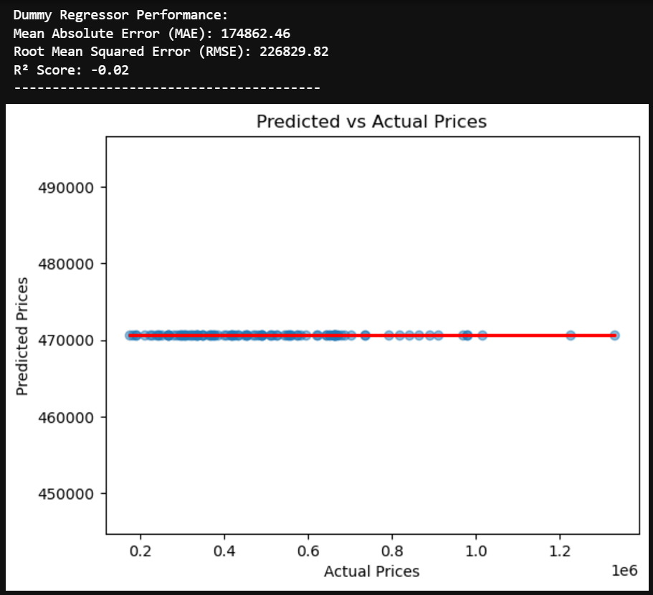
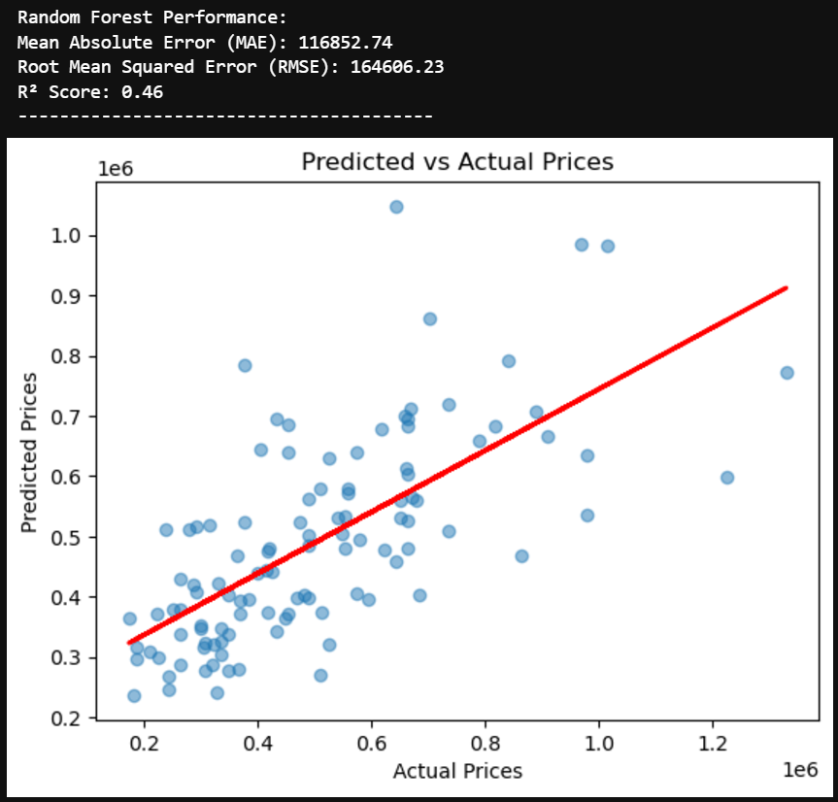
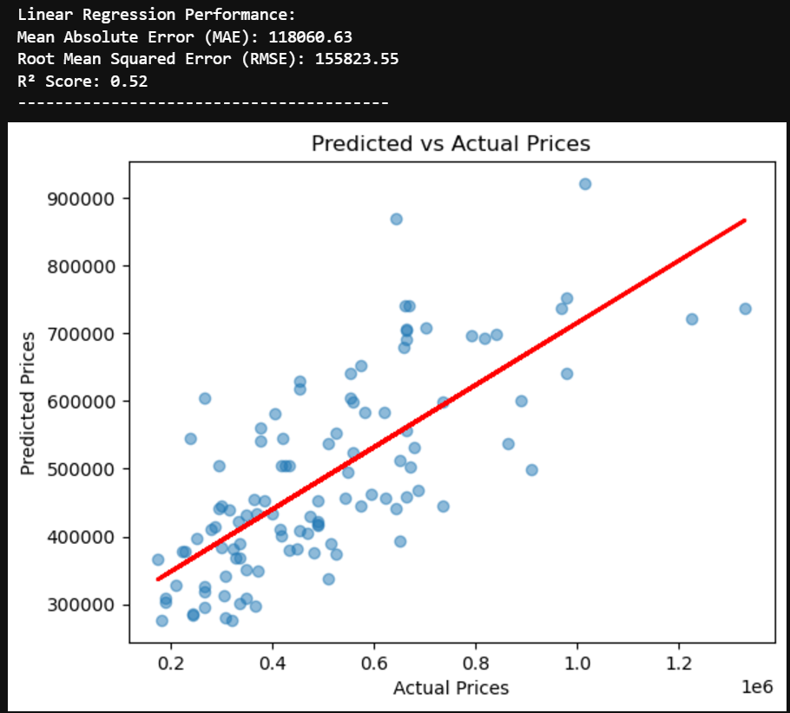
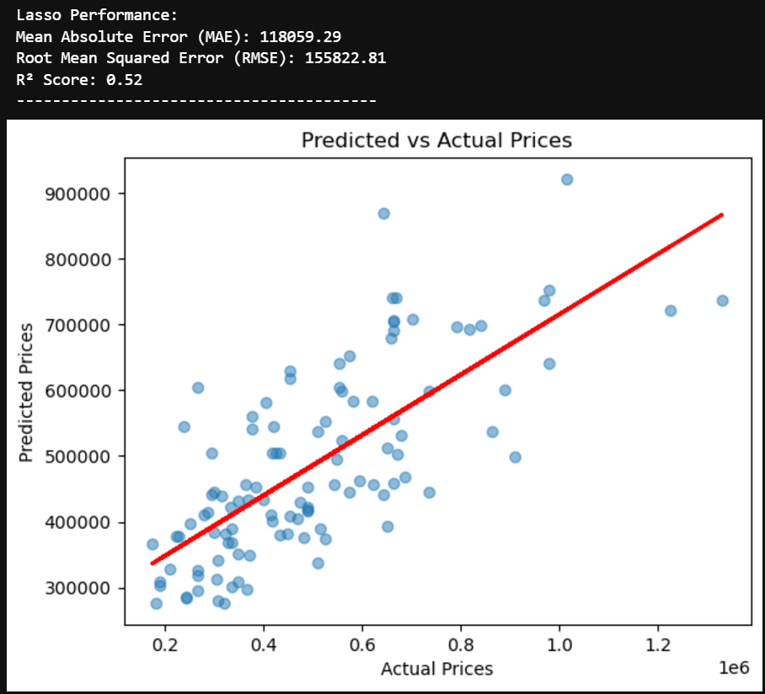
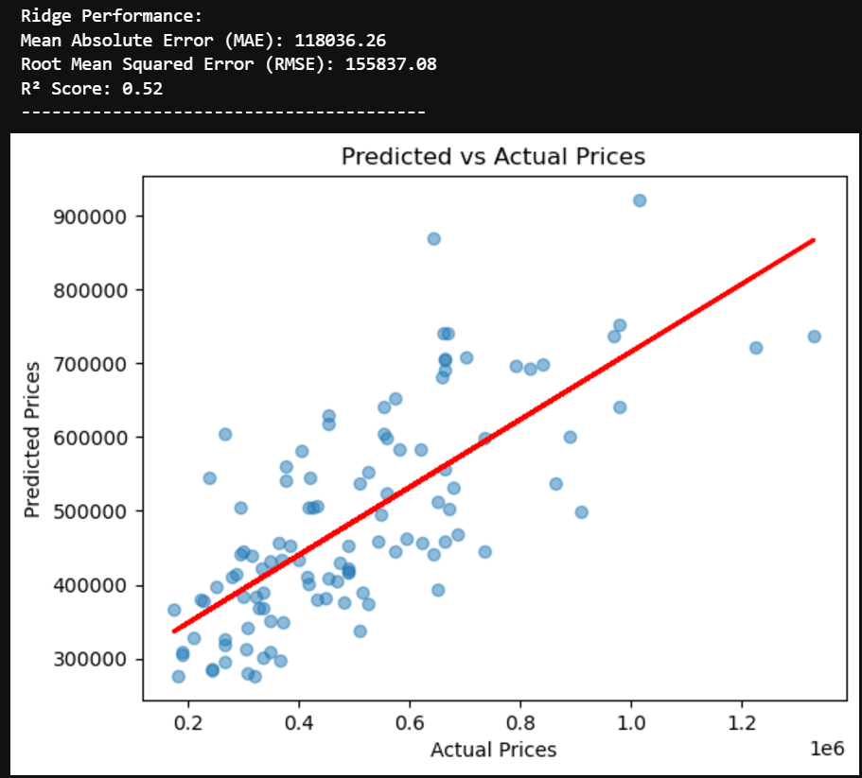
Model Training and Evaluation

Slide 9
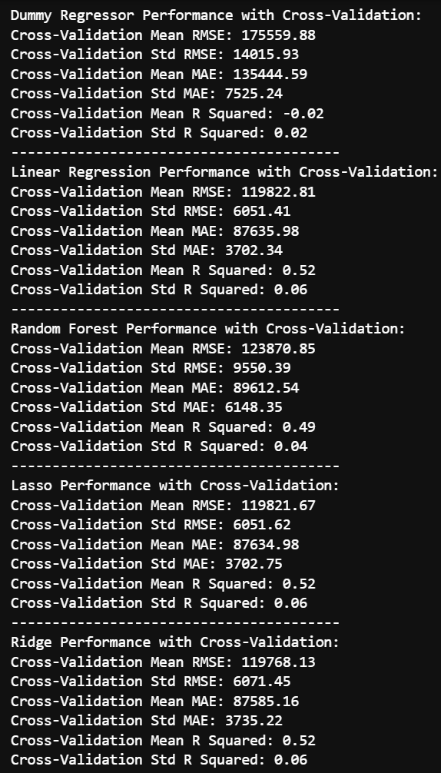
Cross Validation
Using cross validation to ensure that the results were accurate. Cross validation shows similar results, with MAE having a decent improvement

Slide 10
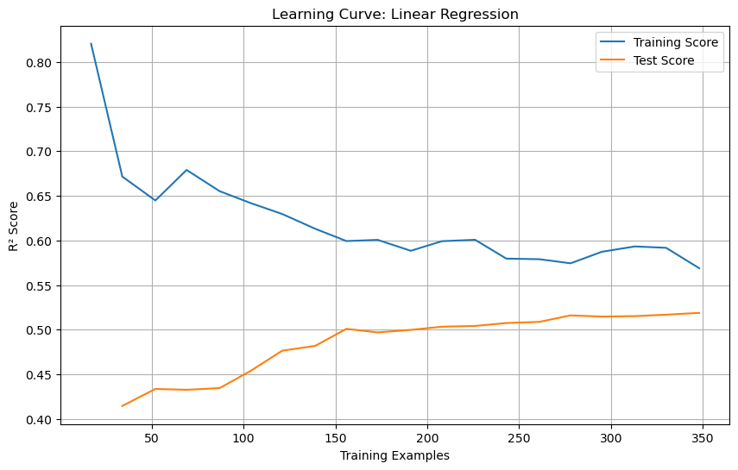
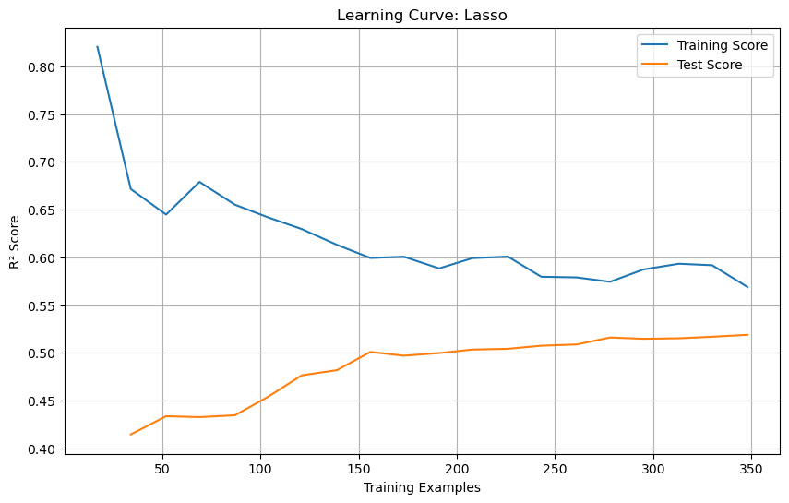
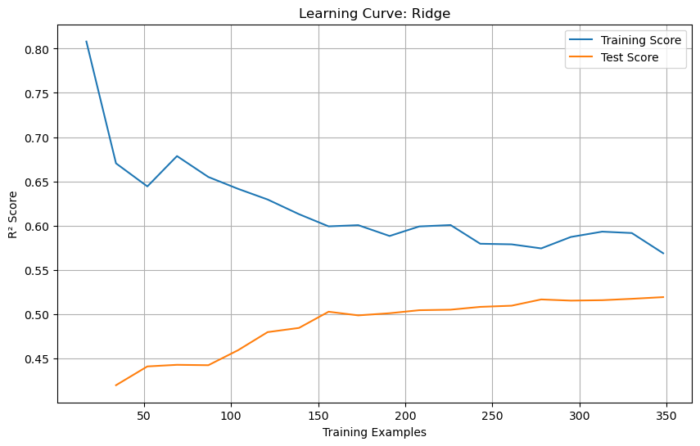
Underfitting Check
Creating a learning curve for the three models with similar scores, Linear Regression, Lasso and Ridge, I am able to check for underfitting. From the results, the models have decent training and test scores. The lower scores is probably due to the outliers and small dataset

Slide 11
Hyperparameter Tuning
I chose hyperparameters for Lasso and Ridge to try and balance model complexity and regularization. I used RandomizedSearchCV as the dataset is very small, so using GridSearchCV could lead to overfitting and high variance

Slide 12
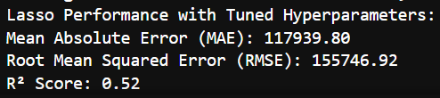
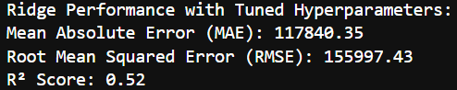
Final Results with Hyperparameter Tuning
From the results, Lasso had a slight improvement in both MAE and RMSE, while Ridge, had a slight improvement in MAE, but RMSE slightly worsened

Slide 13
Conclusion
From making the machine, I have discovered how a small dataset can affect the results of a model, even without missing values. I also discovered that even though there may be outliers, sometimes they should not be removed as it represents real, valid data. Removing it could lead to erasing important variability.
Overall, both Lasso and Ridge gave a decent result, considering to small dataset.

